Slide 1
Open Labs: Unity Module
Robert Worbey, Jamie Ley, Alexis Sanders, James Rabuzzi, Leela Pinnamaraju

Slide 2
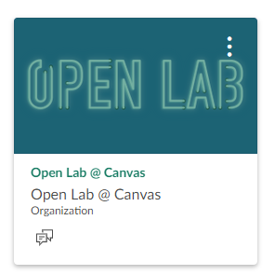
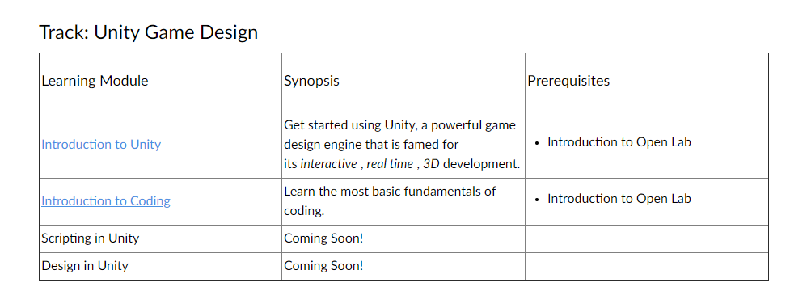
What we did for the last two weeks
Notes:
Voiceover: worked through open labs for unity

Slide 3
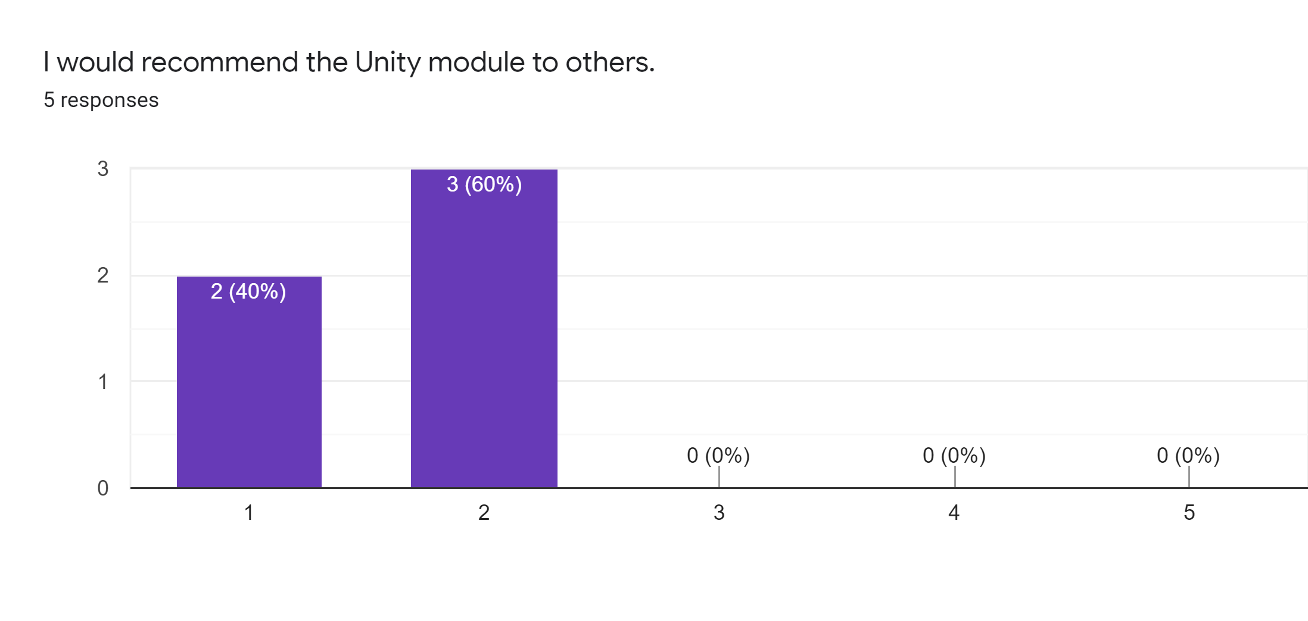
A good summary of our time

Slide 4
Executive Summary
It took us ~3 hours to complete the coursework
We created a system usability survey to determine the success of Open Labs Unity module
Used Likert scale to quantify (1 = strongly disagree; 5 = agree)
Our findings:
Virtually everyone would not recommend (1.6/5 average)
It was easy to use (3.6/5 average)
We did learn something (4/5 average)
We didn’t have to have any prior knowledge (1.6/5 average)
We didn’t particularly enjoy it (2/5 average)
We also prepared a bug report with feedback for each module

Slide 5
What we learned
Pre-Requisites | Module 1: Getting Started With Unity | Module 2: Editing Projects ~ Overview | Module 3: Mad Editing Skillz | Module 4: Putting It All Together
A little bit about resources available How Open Labs allows access to resources which students may not normally have encountered | What Unity is & how to download software | Basic Unity facts | About models and material Basic UI controls Bringing in assets to a unity project | How to place a ground plane and import multiple assets

Slide 6
Bug Report Summary
Highest priority - bottleneck bug
Context: Essentially before the last module, you had to do a self-graded assignment that required admin approval (but the admin was unaware that they needed to approve). Required team to email admin.
Medium priority - quiz errors
Context: To pass each course you needed 100% on quizzes. One examples of errors in this category include a quiz with a question with duplicate options.

Slide 7
Learn.unity.com vs. Open Lab Module
The Learn Unity module is future proofed because it tells which exact version of Unity to install
Learn Unity acknowledges the microgames
The Learn Unity tutorials focus on fundamental skill sets
The Open Lab modules allows Pitt students to learn about Unity
Open Lab focuses on an introductory course to Unity
Open Lab video advisors shared useful tips to new users

Slide 8
Recommendations for Open Lab
Recreating the wheel:
Recommendation: Consider using material from learn.unity.com, which already has a great program.
Reframing quizzes:
Context: A big part of the modules are the quizzes; however, it would be more beneficial for students to learn why they missed a question rather than what is implemented now.
Recommendation:
Open Lab should make it so students don’t have to retake the entire quiz, but only the questions that they missed.
It should also provide what was right and wrong, as well as an explanation for each question in order to really help students learn.
Assignment updates:
Recommendation:
Make the last two assignments more unique from each other.
The second one focused on importing assets, the last one was also mainly importing assets.
Add more clarity surrounding assignments.
Adding supporting material:
Recommendation: Add links to supporting material for content.

